Slide 1
Unit 5
Lecture 5

Slide 2
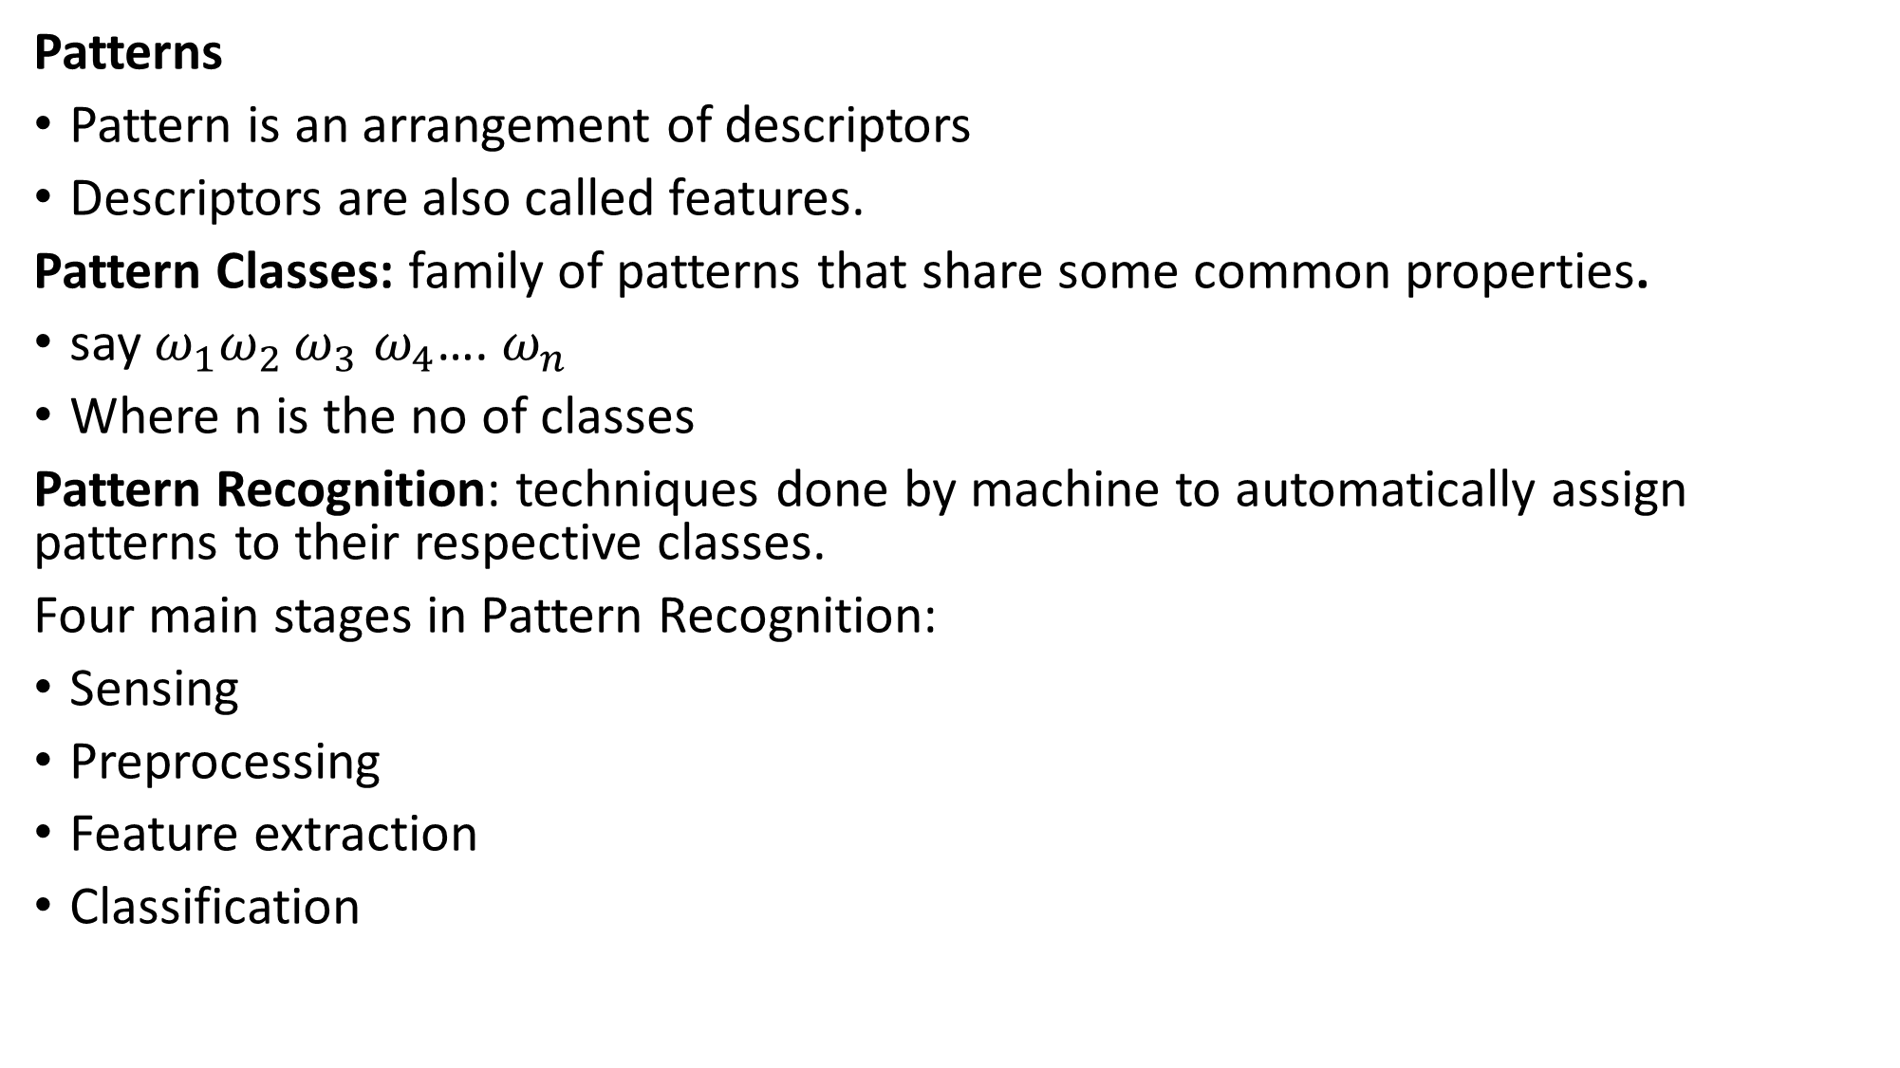
Patterns
Pattern is an arrangement of descriptors
Descriptors are also called features.
Pattern Classes: family of patterns that share some common properties.
say $ω_{1}ω_{2 }ω_{3}$ $ω_{4}$…. $ω_{n }$
Where n is the no of classes
Pattern Recognition: techniques done by machine to automatically assign patterns to their respective classes.
Four main stages in Pattern Recognition:
Sensing
Preprocessing
Feature extraction
Classification

Slide 3
Common pattern arrangements
Vectors
Pattern vectors are represented as below
x_{i} represent the i^{th} descriptor and n is the total no. of descriptors associated with the pattern
Represented commonly as columns (n x 1 matrices)

Slide 4
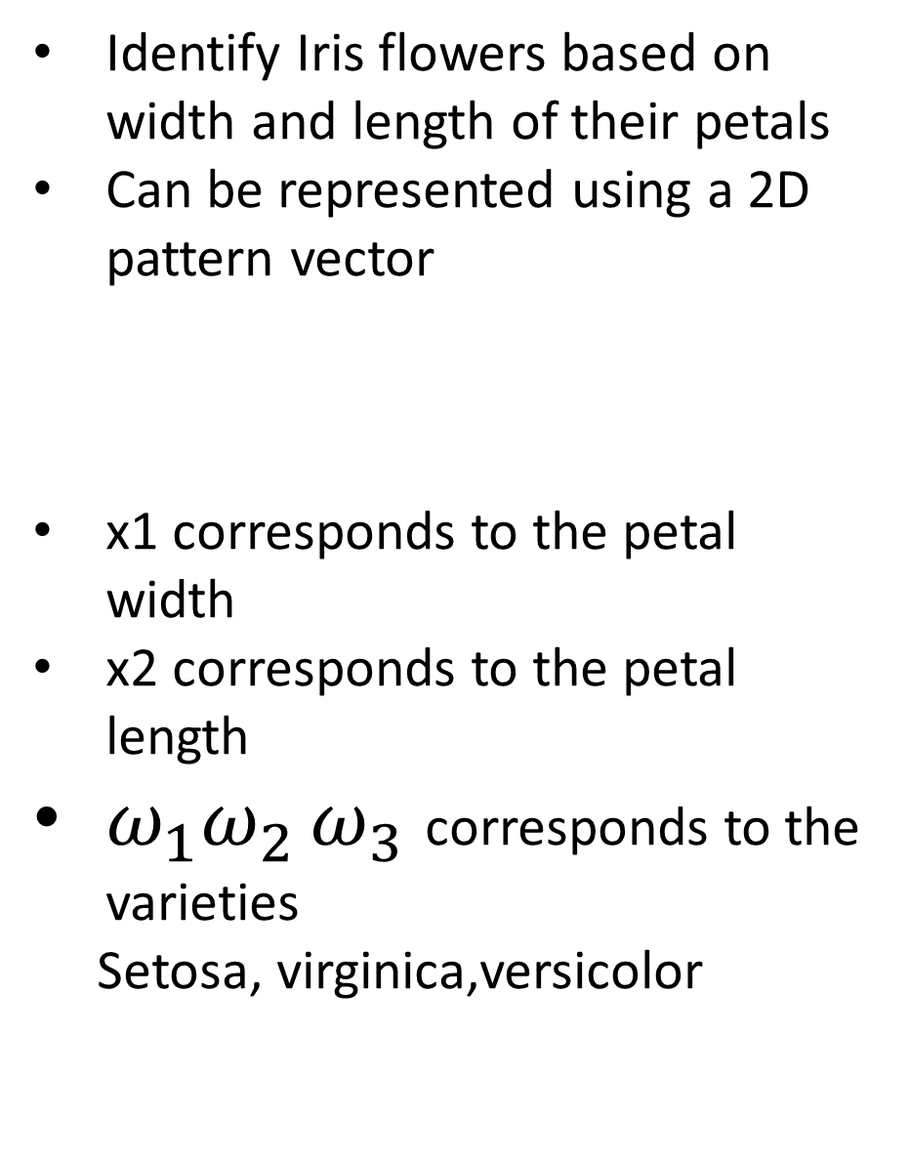
Identify Iris flowers based on width and length of their petals
Can be represented using a 2D pattern vector
x1 corresponds to the petal width
x2 corresponds to the petal length
$ω_{1}ω_{2 }ω_{3}$ corresponds to the varieties
Setosa, virginica,versicolor

Slide 5
2. Strings
Based on connectivity of primitives, example boundary shape
Define elements like a and b
Patterns will be string of symbols ababaab….

Slide 6
3. Trees
Powerful approach for many applications

Slide 7
Tree description of the image

Slide 8
Patterns are used for Object Recognition
Recognition of objects also called patterns in individual image regions
Different methods used for pattern classification:
Classification based on matching unknown patterns against specified prototype
Optimum statistical classifier
Neural Networks

Slide 9
Classification based on prototypes
Pattern or Feature based recognition
We assume every object is represented by a set of patterns or features called Feature vector
Feature vector F has n no of point
In an n dimensional space F is represented as a point
If we have a class of such objects every object will have its own F and all will be close to one another
They will form a cluster
If we have k no of such clusters in an n dimensional space I can representall of them as k clusters
We can define a classifier using these concepts

Slide 10
Consider Iris dataset four features
Petal length(x1) petal width(x2) sepal length(x3) sepal width(x4)
x=[x1,x2,x3,x4]
N:Dimension of the feature vector x is 4
For understanding let us take 2 features x1 and x2
How to decide a classifier for this two classes?
I have to find a line which will separate the classes say g(x)
g(X1^) >0 and g(X2^)<0
Now for any unknown feature vector I have to find we have to find out what is the value of g
g is called the discriminant function

Slide 11
We have more than 2 classes say m
Every m will have a discriminant function g
If g(xi)>g(xj) where i<>j the object belongs to the class i
Example of such a classifier: minimum distance classifier
Correlation based matching
Optimum statistical classifier
Probabilistic approach
What is the probability that the feature vector x came from class k1 when it actually came from k2
P(k1|x) and P(k2|x)
If the classifier says it came form class k2 when it actually came from k1 there is a loss incurred by say L(k1k2)
We can find the average of all such losses and this must be minimum

Slide 12
Classifier will assign the object to a class for which the average loss is minimum
E.g : Bayesian classifier
Concept of pattern recognition in the above methods: Feature vector engineered by humans used to transform raw data into a representation suitable for recognition.
Neural Networks
First neuron: MP neuron (1940)
Perceptron
Based on the Backpropagation concept: automatically learn representations suitable for recognition
Each layer in the network refines this representation to a more abstract form of representation
Multilayered learning: Deep learning
We have to just specify parameters like no. of layers and some other parameters
Example: CNN for image pattern classification

